Slide 1
Pedestrian tracking
VUT FIT POVa
Lukáš Petrovič, Filip Šťastný, Martin Vondráček
2019-01-09

Slide 2
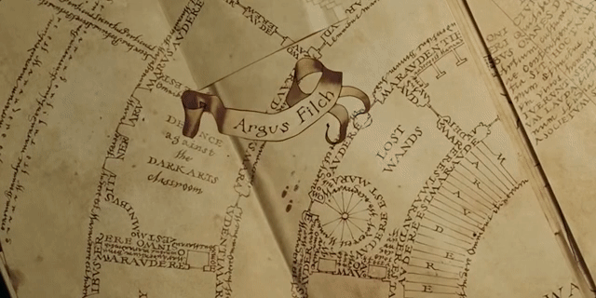
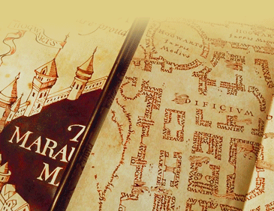
Task Inspiration
Marauder's Map from Harry Potter
Magic parchment that reveals the current location of anyone on Hogwarts grounds
http://harrypotter.wikia.com/wiki/Marauder%27s_Map

Slide 3
Task definition
Multiple people walking in a scene
Multiple stationary cameras
Initial calibration
Individual path tracking

Slide 4
Processing pipeline

Slide 5
Processing pipeline

Slide 6
Processing pipeline

Slide 7
Processing pipeline

Slide 8
Processing pipeline

Slide 9
Processing pipeline

Slide 10
Processing pipeline

Slide 11
Human Detection in 2D
OpenPose deep neural network
Pretrained model with COCO dataset
Left hip, right hip, neck → bounding box

Slide 12
Human Detection in 2D
TODO graph speed
OpenPoseDetector
OpenPoseBinaryDetector CPU
OpenPoseBinaryDetector GPU

Slide 13
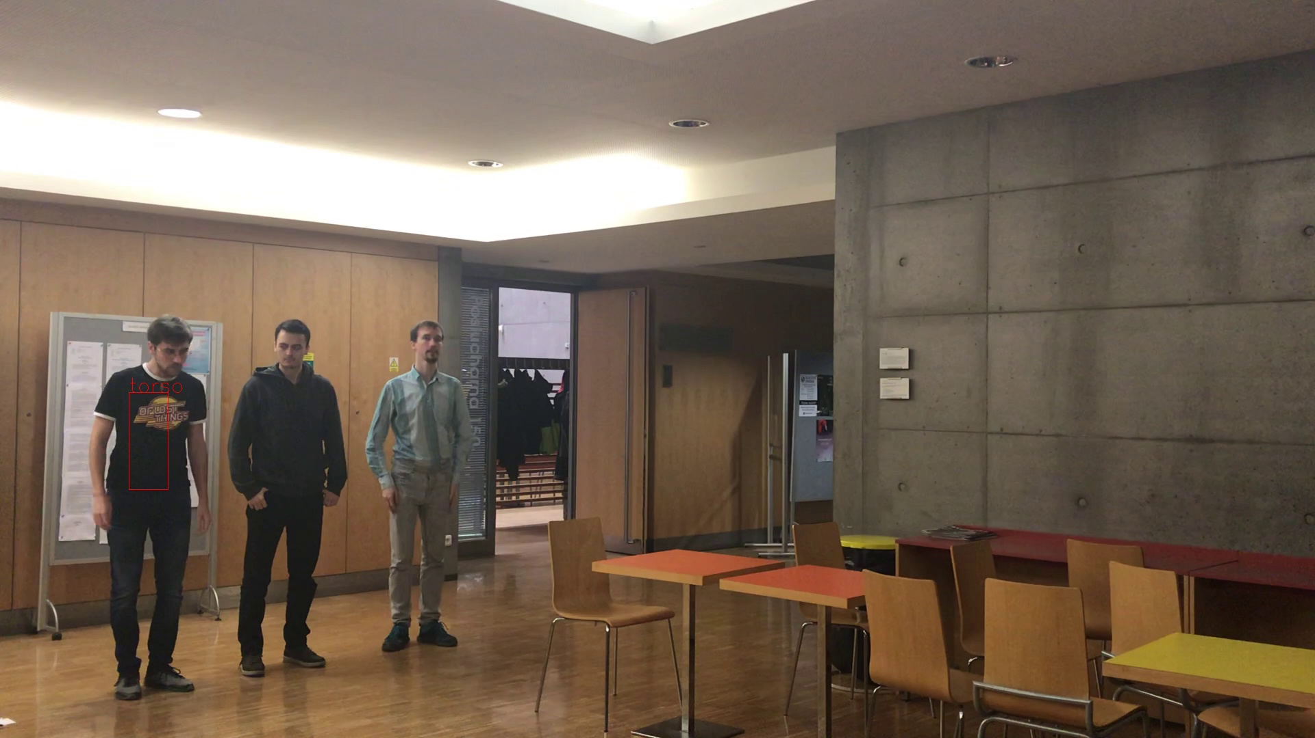
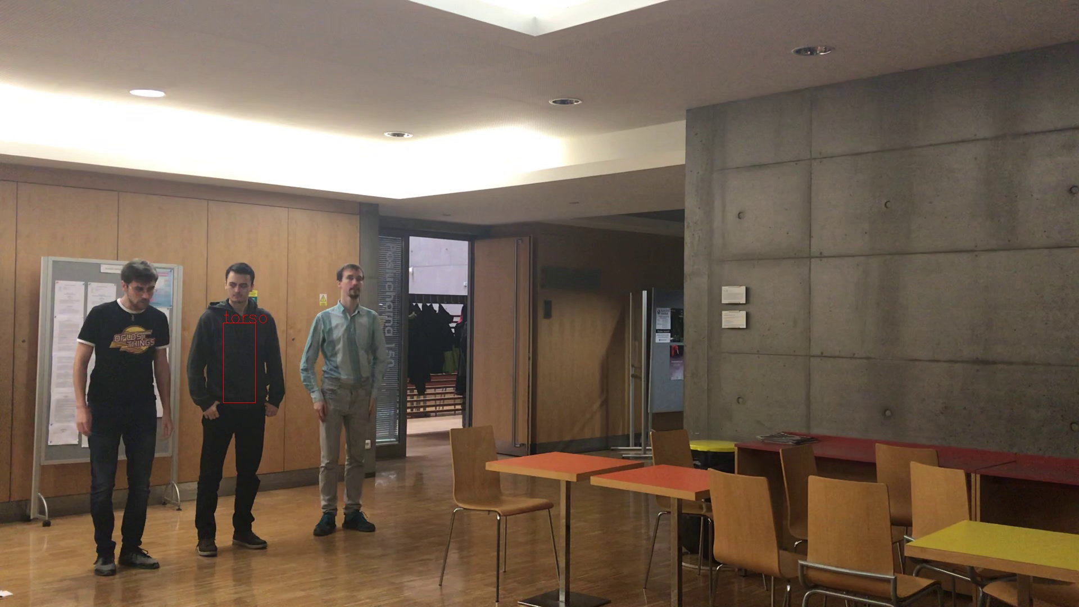

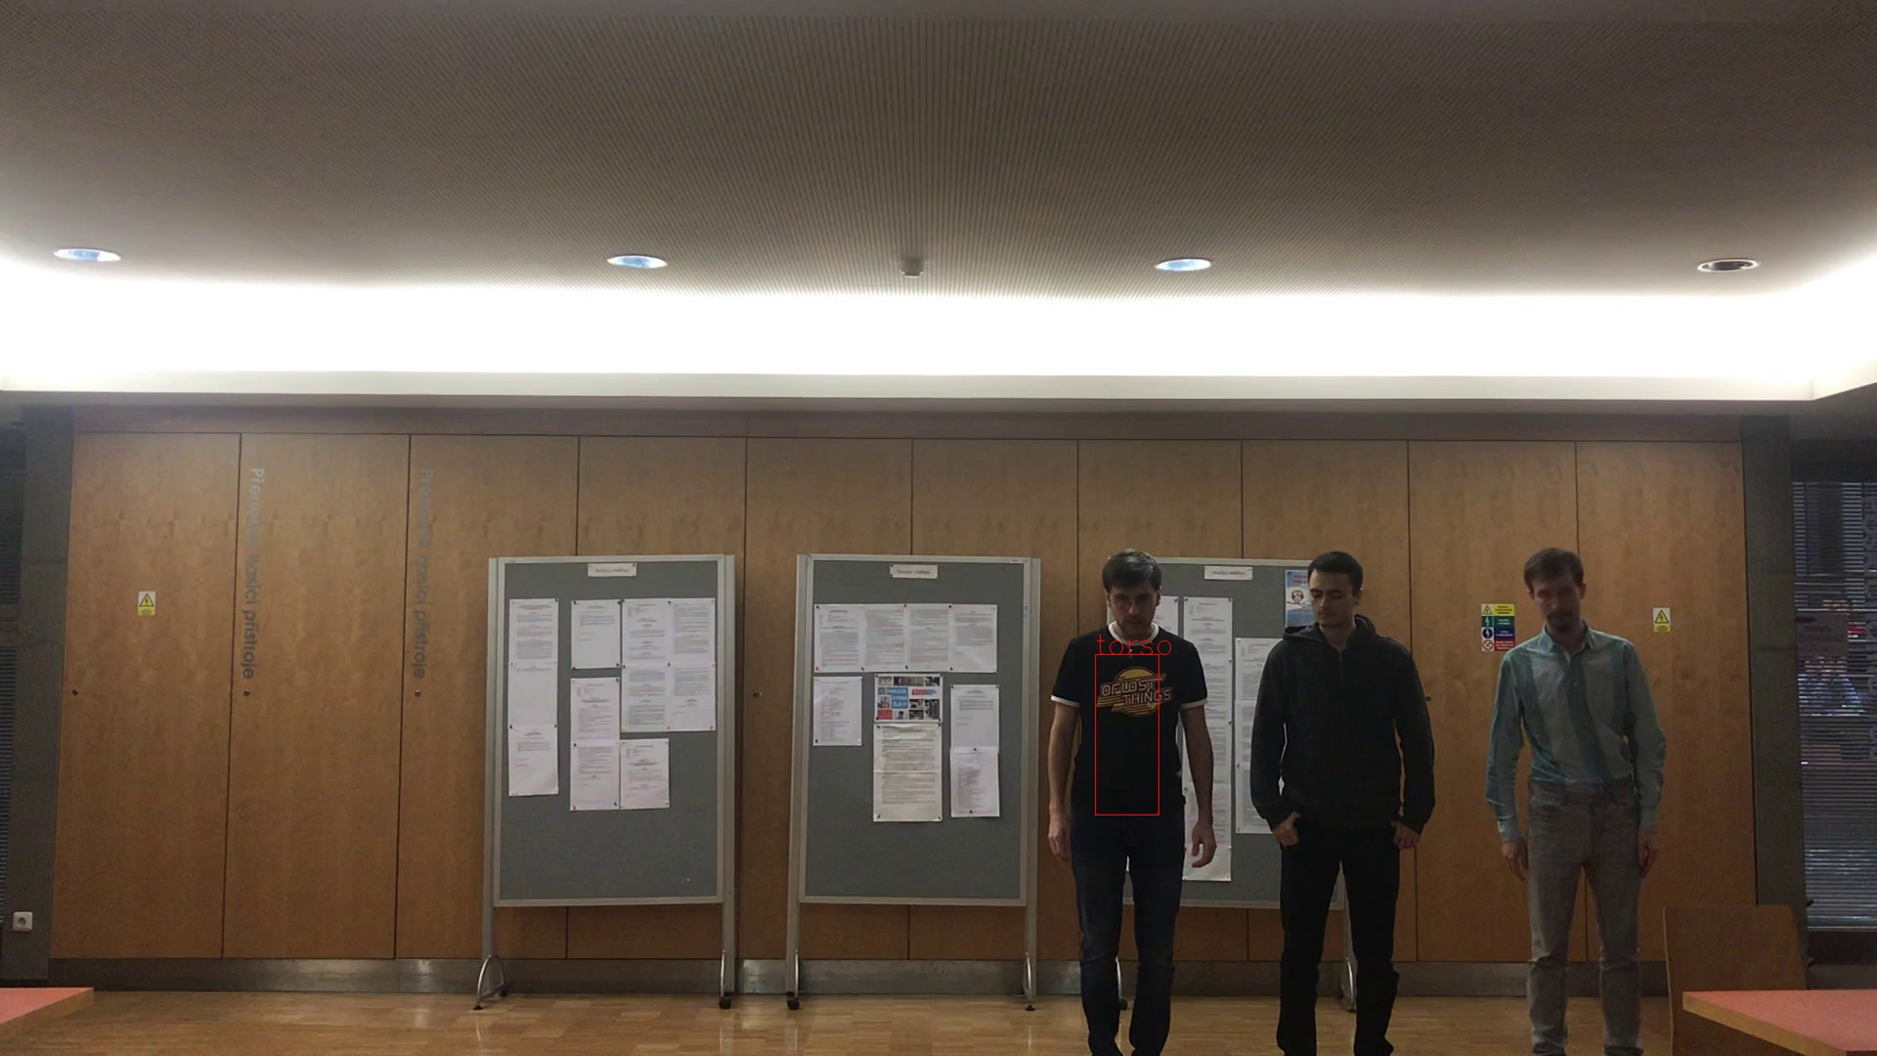


Person View Matching
Similar torso histograms → same person
Side person views
Front person views

Slide 14
Person View Matching
Similar torso histograms → same person
PersonTimeFrame A
PersonTimeFrame B
PersonTimeFrame C

Slide 15
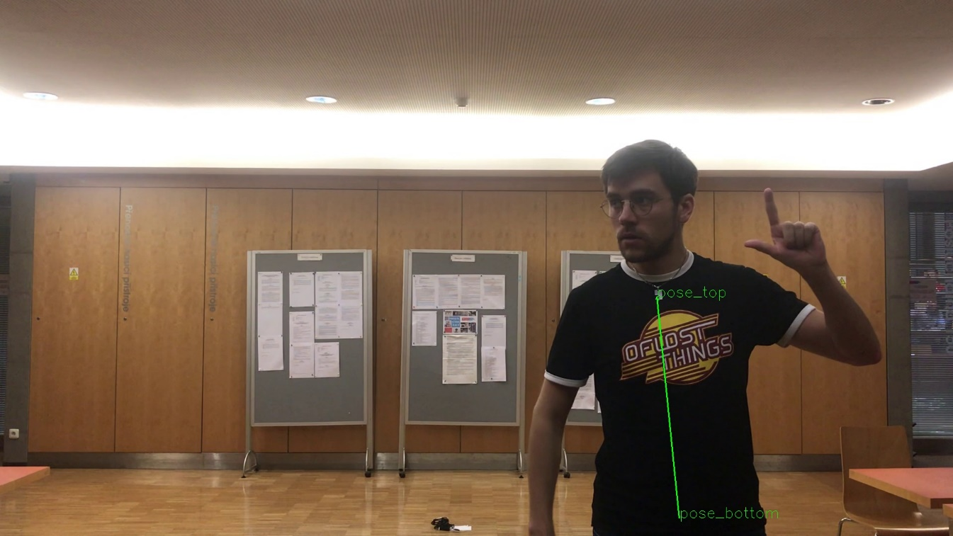
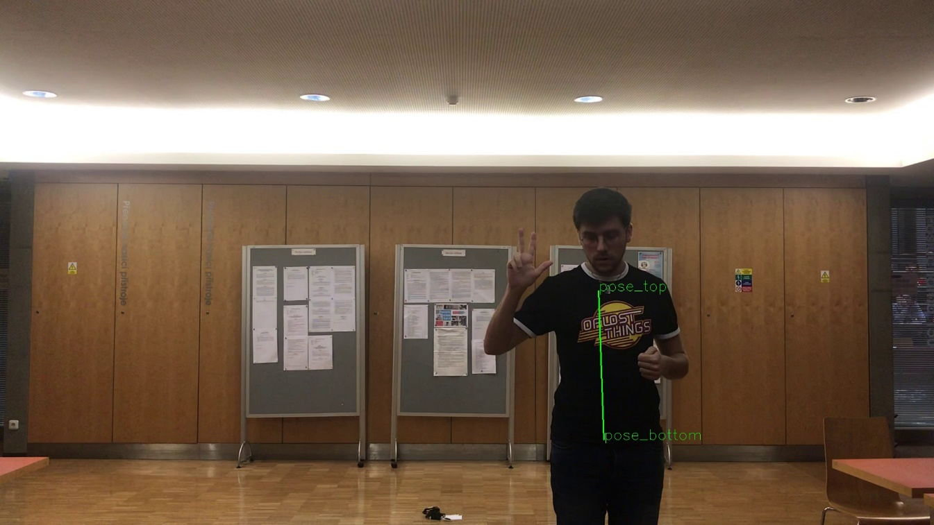
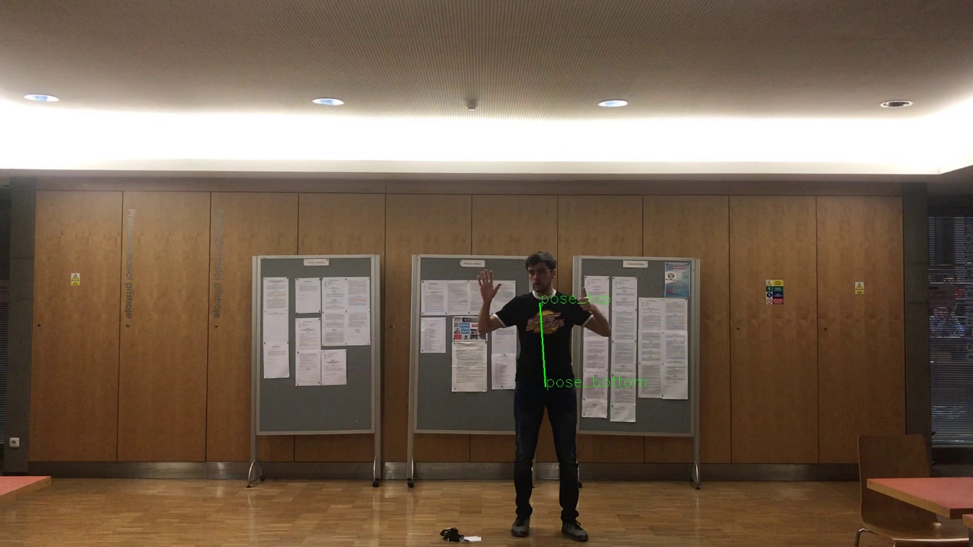
Triangulation
Average person’s torso → distance from camera
y = 2 m
y = 3 m
y = 6 m

Slide 16
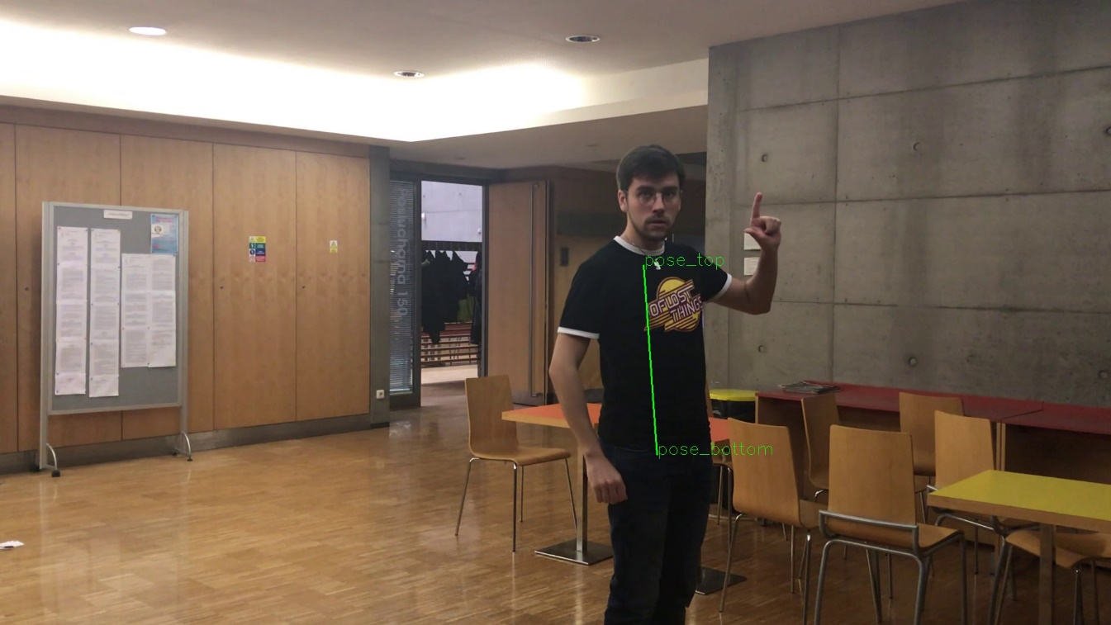
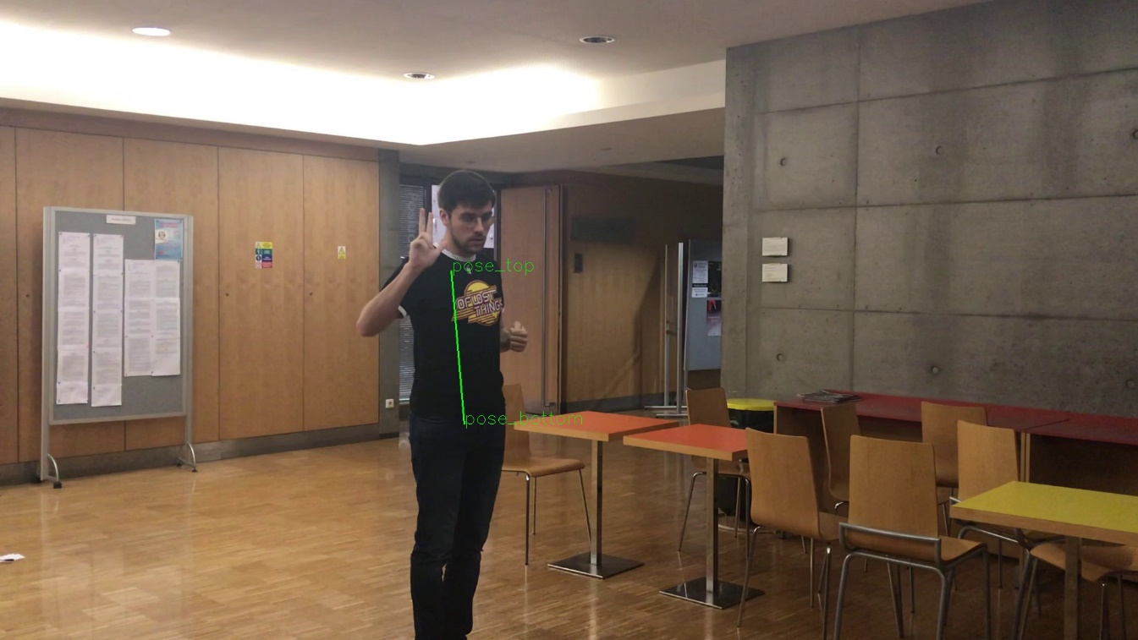
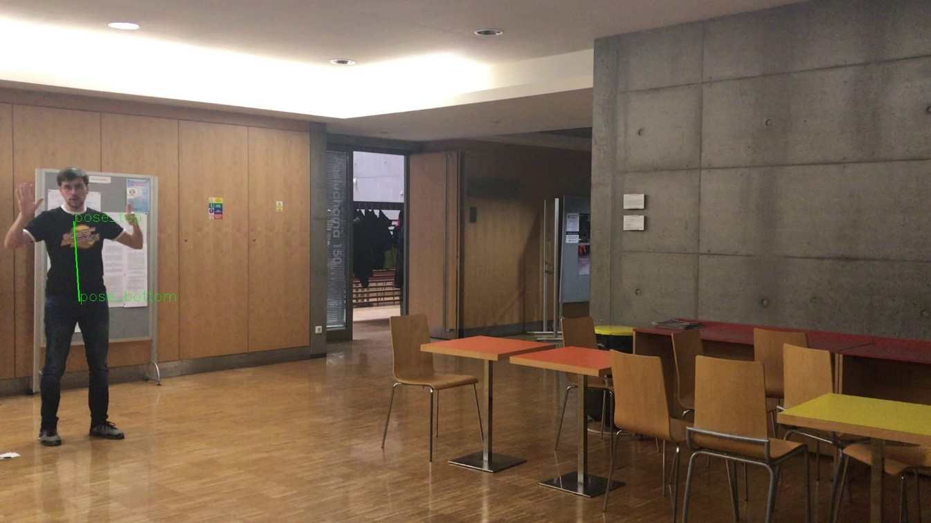
Triangulation
Average person’s torso → distance from camera
y = 2 m
y = 3 m
y = 6 m

Slide 17
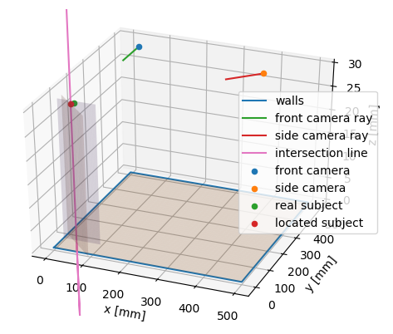
Triangulation
Intersection of distance planes → person‘s position

Slide 18
Person Tracking
Based on image histograms
TODO persontimeframes

Slide 19
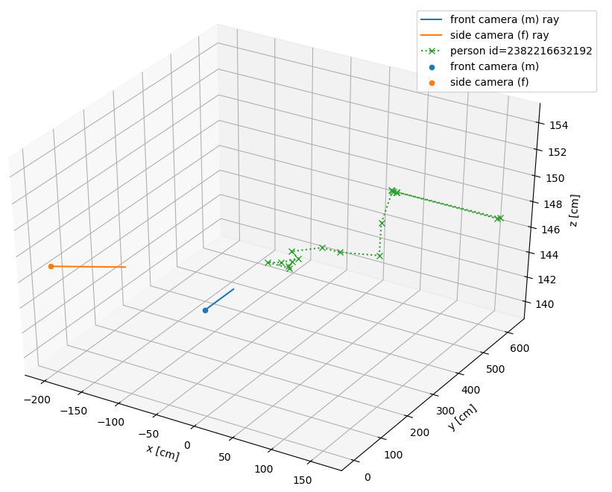
Visualisation
Paths of all tracked people, positions of cameras
Interactive 3D model

Slide 20
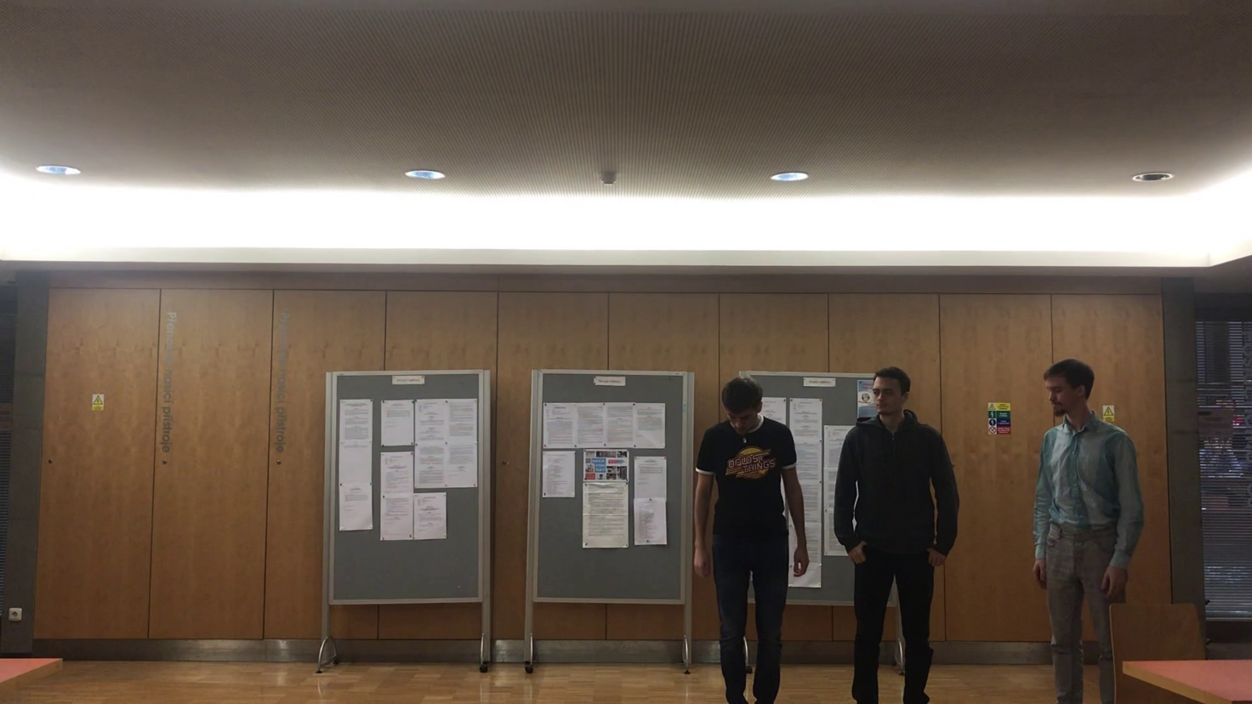
Testing Data
Own images, COCO dataset for OpenPose

Slide 21
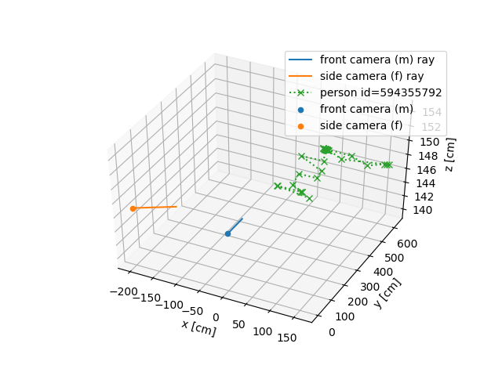
Evaluation

Slide 22
Thank you for your attention.

